Slide 1
Digital image processing
Dr. Cheng-Fa Tsai
Professor, Dept. of Management Information Systems
National Pingtung University of Science & Technology

Slide 2
Contents
1 History
1.1 Image sensors
1.2 Image compression
1.3 Digital signal processor (DSP)
1.4 Medical imaging
Tasks
3 Digital image transformations
3.1 Filtering
3.2 Image padding in Fourier domain filtering
3.3 Filtering code examples
3.4 Affine transformations
4 Applications
4.1 Digital camera images
4.2 Film
5 See also
6 References
7 Further reading
8 External links

Slide 3

introduction
In computer science, digital image processing is the use of a digital computer to process digital images through an algorithm.
As a subcategory or field of digital signal processing, digital image processing has many advantages over analog image processing.
It allows a much wider range of algorithms to be applied to the input data and can avoid problems such as the build-up of noise and distortion during processing.
Since images are defined over two dimensions (perhaps more) digital image processing may be modeled in the form of multidimensional systems has increased.

Slide 4
introduction
The generation and development of digital image processing are mainly affected by three factors:
first, the development of computers;
second, the development of mathematics (especially the creation and improvement of discrete mathematics theory);
third, the demand for a wide range of applications in environment, agriculture, military, industry and medical science has increased.

Slide 5
1. History
Many of the techniques of digital image processing, or digital picture processing as it often was called, were developed in the 1960s, at Bell Laboratories, the Jet Propulsion Laboratory, Massachusetts Institute of Technology, University of Maryland, and a few other research facilities, with application to satellite imagery, wire-photo standards conversion, medical imaging, videophone, character recognition, and photograph enhancement.

Slide 6
1. History
The purpose of early image processing was to improve the quality of the image. It was aimed for human beings to improve the visual effect of people.
In image processing, the input is a low-quality image, and the output is an image with improved quality. Common image processing include image enhancement, restoration, encoding, and compression.
The first successful application was the American Jet Propulsion Laboratory (JPL).

Slide 7
1. History
They used image processing techniques such as geometric correction, gradation transformation, noise removal, etc. on the thousands of lunar photos sent back by the Space Detector Ranger 7 in 1964, taking into account the position of the sun and the environment of the moon.

Slide 8
1. History
The impact of the successful mapping of the moon's surface map by the computer has been a huge success.
Later, more complex image processing was performed on the nearly 100,000 photos sent back by the spacecraft, so that the topographic map, color map and panoramic mosaic of the moon were obtained, which achieved extraordinary results and laid a solid foundation for human landing on the moon.

Slide 9
1. History
The cost of processing was fairly high, however, with the computing equipment of that era.
That changed in the 1970s, when digital image processing proliferated as cheaper computers and dedicated hardware became available.

Slide 10
1. History
This led to images being processed in real-time, for some dedicated problems such as television standards conversion.
As general-purpose computers became faster, they started to take over the role of dedicated hardware for all but the most specialized and computer-intensive operations.
With the fast computers and signal processors available in the 2000s, digital image processing has become the most common form of image processing, and is generally used because it is not only the most versatile method, but also the cheapest.

Slide 11
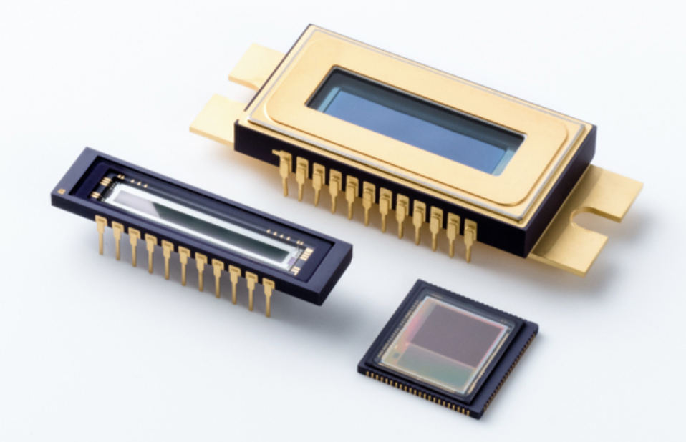
1.1 Image sensors
The basis for modern image sensors is metal-oxide-semiconductor (MOS) technology, which originates from the invention of the MOSFET (MOS field-effect transistor) by Mohamed M. Atalla and Dawon Kahng at Bell Labs in 1959.
This led to the development of digital semiconductor image sensors, including the charge-coupled device (CCD) and later the CMOS sensor.
The charge-coupled device was invented by Willard S. Boyle and George E. Smith at Bell Labs in 1969. While researching MOS technology, they realized that an electric charge was the analogy of the magnetic bubble and that it could be stored on a tiny MOS capacitor.

Slide 12
1.1 Image sensors
As it was fairly straighforward to fabricate a series of MOS capacitors in a row, they connected a suitable voltage to them so that the charge could be stepped along from one to the next.
The CCD is a semiconductor circuit that was later used in the first digital video cameras for television broadcasting.

Slide 13
1.1 Image sensors
The NMOS active-pixel sensor (APS) was invented by Olympus in Japan during the mid-1980s.
This was enabled by advances in MOS semiconductor device fabrication, with MOSFET scalingreaching smaller micron and then sub-micron levels.
The NMOS APS was fabricated by Tsutomu Nakamura's team at Olympus in 1985.
The CMOS active-pixel sensor (CMOS sensor) was later developed by Eric Fossum's team at the NASA Jet Propulsion Laboratory in 1993.
By 2007, sales of CMOS sensors had surpassed CCD sensors.

Slide 14
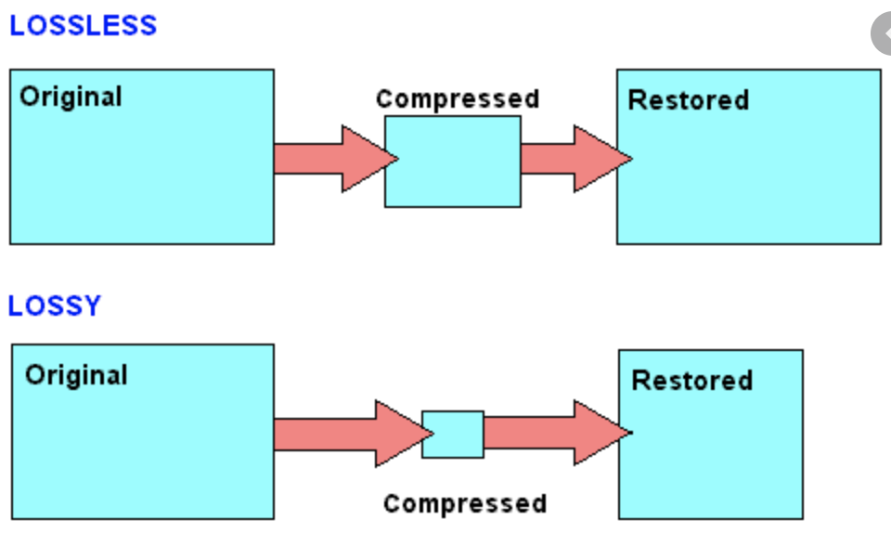
1.2 Image compression
An important development in digital image compression technology was the discrete cosine transform (DCT), a lossy compression technique first proposed by Nasir Ahmed in 1972.
DCT compression became the basis for JPEG, which was introduced by the Joint Photographic Experts Group in 1992.

Slide 15
1.2 Image compression
JPEG compresses images down to much smaller file sizes, and has become the most widely used image file format on the Internet.
Its highly efficient DCT compression algorithm was largely responsible for the wide proliferation of digital images and digital photos,with several billion JPEG images produced every day as of 2015.

Slide 16
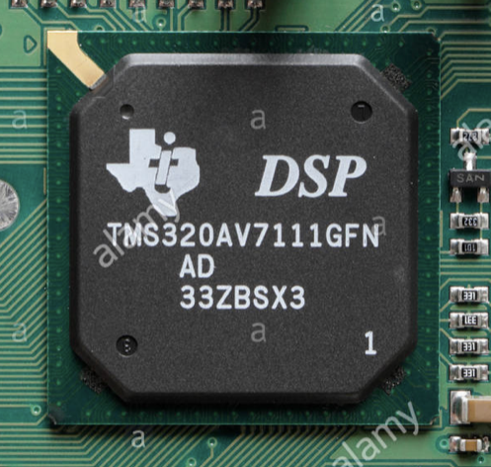
1.3 Digital signal processor (DSP)
Electronic signal processing was revolutionized by the wide adoption of MOS technology in the 1970s.MOS integrated circuit technology was the basis for the first single chip microprocessors and microcontrollers in the early 1970s,and then the first single-chip digital signal processor (DSP) chips in the late 1970s.
DSP chips have since been widely used in digital image processing.

Slide 17
1.3 Digital signal processor (DSP)
The discrete cosine transform (DCT) image compression algorithm has been widely implemented in DSP chips, with many companies developing DSP chips based on DCT technology.
DCTs are widely used for encoding, decoding, video coding, audio coding, multiplexing, control signals, signaling, analog-to-digital conversion, formatting luminance and color differences, and color formats such as YUV444 and YUV411.

Slide 18
1.3 Digital signal processor (DSP)
DCTs are also used for encoding operations such as motion estimation, motion compensation, inter-frame prediction, quantization, perceptual weighting, entropy encoding, variable encoding, and motion vectors, and decoding operations such as the inverse operation between different color formats (YIQ, YUV and RGB) for display purposes.
DCTs are also commonly used for high-definition television (HDTV) encoder/decoder chips.

Slide 19
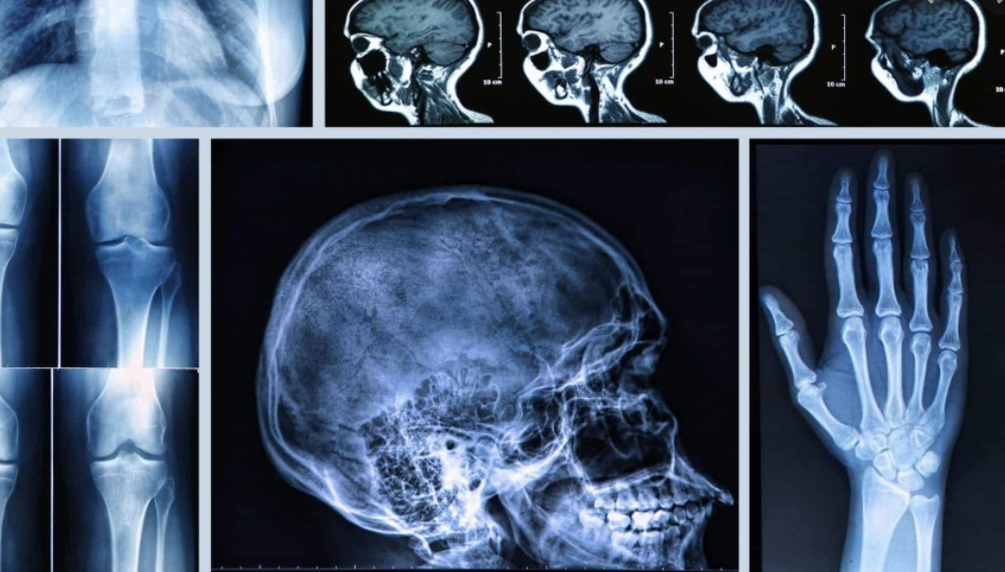
1.4 Medical imaging
In 1972, the engineer from British company EMI Housfield invented the X-ray computed tomography device for head diagnosis, which is what we usually called CT(Computer Tomography).
The CT nucleus method is based on the projection of the human head section and is processed by computer to reconstruct the cross-sectional image, which is called image reconstruction.

Slide 20

1.4 Medical imaging
In 1975, EMI successfully developed a CT device for the whole body, which obtained a clear tomographic image of various parts of the human body. In 1979, this diagnostic technique won the Nobel Prize.
Digital image processing technology for medical applications was inducted into the Space Foundation Space Technology Hall of Fame in 1994.

Slide 21

2 Tasks
Digital image processing allows the use of much more complex algorithms, and hence, can offer both more sophisticated performance at simple tasks, and the implementation of methods which would be impossible by analog means.

Slide 22

In particular, digital image processing is the only practical technology for :
Classification(2.1)
Feature extraction(2.2)
Multi-scale signal analysis(2.3)
Pattern recognition(2.4)
Projection(2.5)

Slide 23

Some techniques which are used in digital image processing include:
Anisotropic diffusion(2.6)
Hidden Markov models(2.7)
Image editing(2.8)
Image restoration(2.9)
Independent component analysis(2.10)
Linear filtering(2.11)
Neural networks(2.12)
Partial differential equations(2.13)
Pixelation(2.14)
Point feature matching(2.15)
Principal components analysis(2.16)
Self-organizing maps(2.17)
Wavelets(2.18)

Slide 24
2.1 Classification
In machine learning and statistics, classification is the problem of identifying to which of a set of categories (sub-populations) a new observationbelongs, on the basis of a training set of data containing observations (or instances) whose category membership is known.
Examples are assigning a given email to the "spam" or "non-spam" class, and assigning a diagnosis to a given patient based on observed characteristics of the patient (sex, blood pressure, presence or absence of certain symptoms, etc.).
Classification is an example of pattern recognition.

Slide 25
2.1 Classification
In the terminology of machine learning, classification is considered an instance of supervised learning, i.e., learning where a training set of correctly identified observations is available.
The corresponding unsupervised procedure is known as clustering, and involves grouping data into categories based on some measure of inherent similarity or distance.

Slide 26
2.1 Classification
Often, the individual observations are analyzed into a set of quantifiable properties, known variously as explanatory variables or features. These properties may variously be categorical (e.g. "A", "B", "AB" or "O", for blood type), ordinal (e.g. "large", "medium" or "small"), integer-valued (e.g. the number of occurrences of a particular word in an email) or real-valued (e.g. a measurement of blood pressure).
Other classifiers work by comparing observations to previous observations by means of a similarity or distance function.

Slide 27
2.1 Classification
An algorithm that implements classification, especially in a concrete implementation, is known as a classifier. The term "classifier" sometimes also refers to the mathematical function, implemented by a classification algorithm, that maps input data to a category.

Slide 28
2.1 Classification
Terminology across fields is quite varied. In statistics, where classification is often done with logistic regression or a similar procedure, the properties of observations are termed explanatory variables (or independent variables, regressors, etc.), and the categories to be predicted are known as outcomes, which are considered to be possible values of the dependent variable.

Slide 29
2.1 Classification
In machine learning, the observations are often known as instances, the explanatory variables are termed features (grouped into a feature vector), and the possible categories to be predicted are classes.
Other fields may use different terminology: e.g. in community ecology, the term "classification" normally refers to cluster analysis, i.e., a type of unsupervised learning, rather than the supervised learning described in this article.

Slide 30
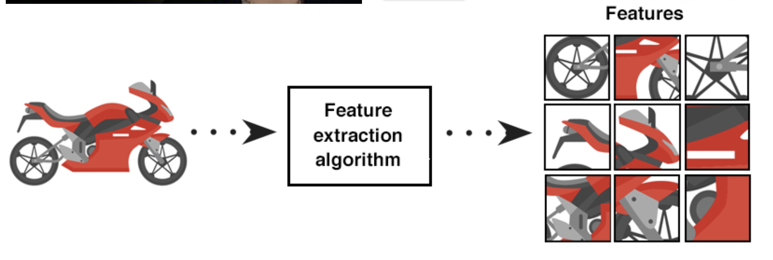
2.2 Feature extraction
In machine learning, pattern recognition and in image processing, feature extraction starts from an initial set of measured data and builds derived values (features) intended to be informative and non-redundant, facilitating the subsequent learning and generalization steps, and in some cases leading to better human interpretations.
Feature extraction is related to dimensionality reduction.

Slide 31
2.2 Feature extraction
When the input data to an algorithm is too large to be processed and it is suspected to be redundant (e.g. the same measurement in both feet and meters, or the repetitiveness of images presented as pixels), then it can be transformed into a reduced set of features (also named a feature vector).

Slide 32
2.2 Feature extraction
Determining a subset of the initial features is called feature selection.
The selected features are expected to contain the relevant information from the input data, so that the desired task can be performed by using this reduced representation instead of the complete initial data.

Slide 33
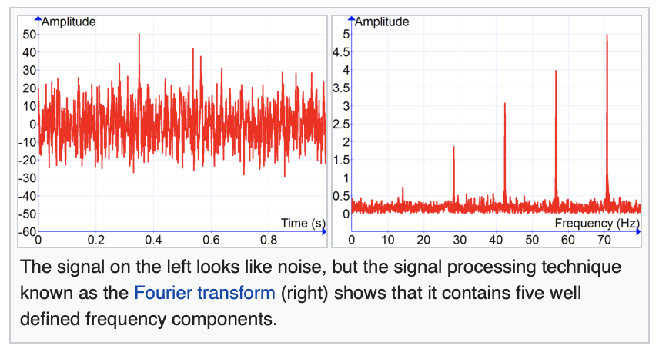
2.3 Multi-scale signal analysis Signal processing
Signal processing is an electrical engineering subfield that focuses on analysing, modifying and synthesizing signals such as sound, images and biological measurements.
Signal processing techniques can be used to improve transmission, storage efficiency and subjective quality and to also emphasize or detect components of interest in a measured signal.

Slide 34

2.4 Pattern recognition
Pattern recognition is the automated recognition of patterns and regularities in data.
Pattern recognition is closely related to artificial intelligence and machine learning, together with applications such as data mining and knowledge discovery in databases (KDD), and is often used interchangeably with these terms.
However, these are distinguished: machine learning is one approach to pattern recognition, while other approaches include hand-crafted (not learned) rules or heuristics; and pattern recognition is one approach to artificial intelligence, while other approaches include symbolic artificial intelligence.

Slide 35
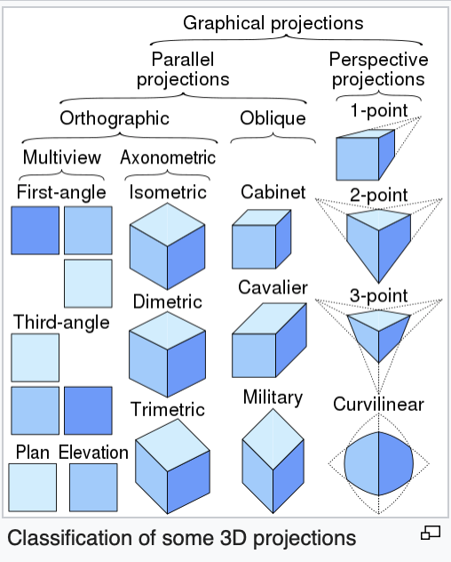
2.5 Projection
3D projection is any method of mapping three-dimensional points to a two-dimensional plane.
As most current methods for displaying graphical data are based on planar (pixel information from several bitplanes) two-dimensional media, the use of this type of projection is widespread, especially in computer graphics, engineering and drafting.

Slide 36

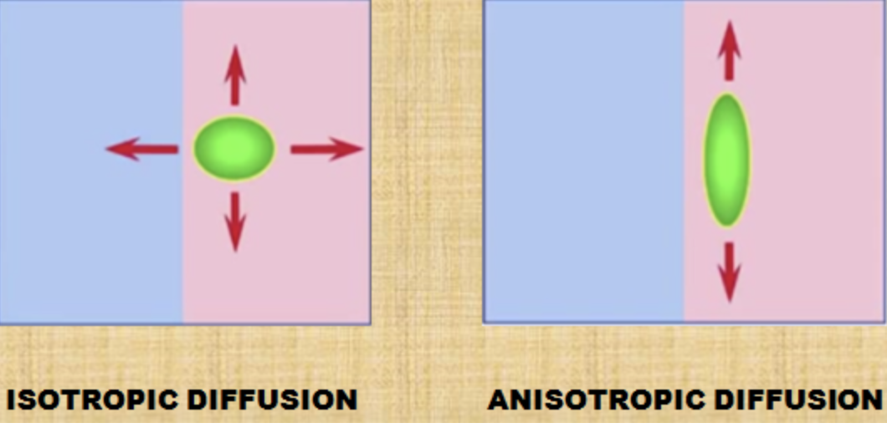
2.6 Anisotropic diffusion
In image processing and computer vision, anisotropic diffusion, also called Perona–Malik diffusion, is a technique aiming at reducing image noise without removing significant parts of the image content, typically edges, lines or other details that are important for the interpretation of the image.

Slide 37
2.6 Anisotropic diffusion
Anisotropic diffusion resembles the process that creates a scale space, where an image generates a parameterized family of successively more and more blurred images based on a diffusion process.
Each of the resulting images in this family are given as a convolution between the image and a 2D isotropic Gaussian filter, where the width of the filter increases with the parameter.

Slide 38
2.6 Anisotropic diffusion
This diffusion process is a linear and space-invariant transformation of the original image.
Anisotropic diffusion is a generalization of this diffusion process:
it produces a family of parameterized images, but each resulting image is a combination between the original image and a filter that depends on the local content of the original image.
As a consequence, anisotropic diffusion is a non-linear and space-variant transformation of the original image.

Slide 39
2.7 Hidden Markov models
Hidden Markov Model (HMM) is a statistical Markov model in which the system being modeled is assumed to be a Markov process with unobservable (i.e. hidden) states.
The hidden Markov model can be represented as the simplest dynamic Bayesian network. The mathematics behind the HMM were developed by L. E. Baum and coworkers.
HMM is closely related to earlier work on the optimal nonlinear filtering problem by Ruslan L. Stratonovich, who was the first to describe the forward-backward procedure.

Slide 40


2.8 Image editing
Image editing encompasses the processes of altering images, whether they are digital photographs, traditional photo-chemical photographs, or illustrations.
Traditional analog image editing is known as photo retouching, using tools such as an airbrush to modify photographs or editing illustrations with any traditional art medium.

Slide 41

2.8 Image editing
Graphic software programs, which can be broadly grouped into vector graphics editors, raster graphics editors, and 3D modelers, are the primary tools with which a user may manipulate, enhance, and transform images.
Many image editing programs are also used to render or create computer art from scratch.

Slide 42
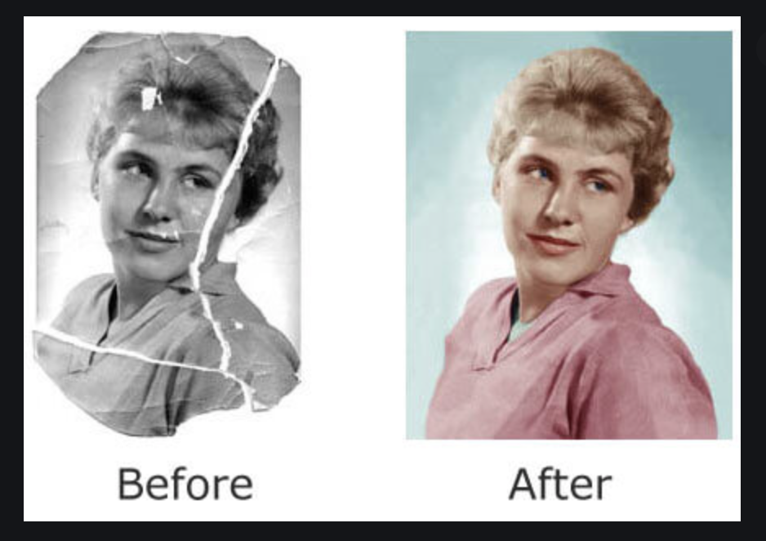
2.9 Image restoration
Image restoration is the operation of taking a corrupt/noisy image and estimating the clean, original image.
Corruption may come in many forms such as motion blur, noise and camera
mis-focus.
Image restoration is performed by reversing the process that blurred the image and such is performed by imaging a point source and use the point source image, which is called the Point Spread Function (PSF) to restore the image information lost to the blurring process.

Slide 43
2.10 Independent component analysis
In signal processing, independent component analysis (ICA) is a computational method for separating a multivariate signal into additive subcomponents.
This is done by assuming that the subcomponents are non-Gaussian signals and that they are statistically independent from each other.
ICA is a special case of blind source separation.
A common example application is the "cocktail party problem" of listening in on one person's speech in a noisy room.

Slide 44
2.11 Linear filtering
Linear filters process time-varying input signals to produce output signals, subject to the constraint of linearity.
In most cases these linear filters are also time invariant (or shift invariant) in which case they can be analyzed exactly using LTI ("linear time-invariant") system theory revealing their transfer functions in the frequency domain and their impulse responses in the time domain.

Slide 45
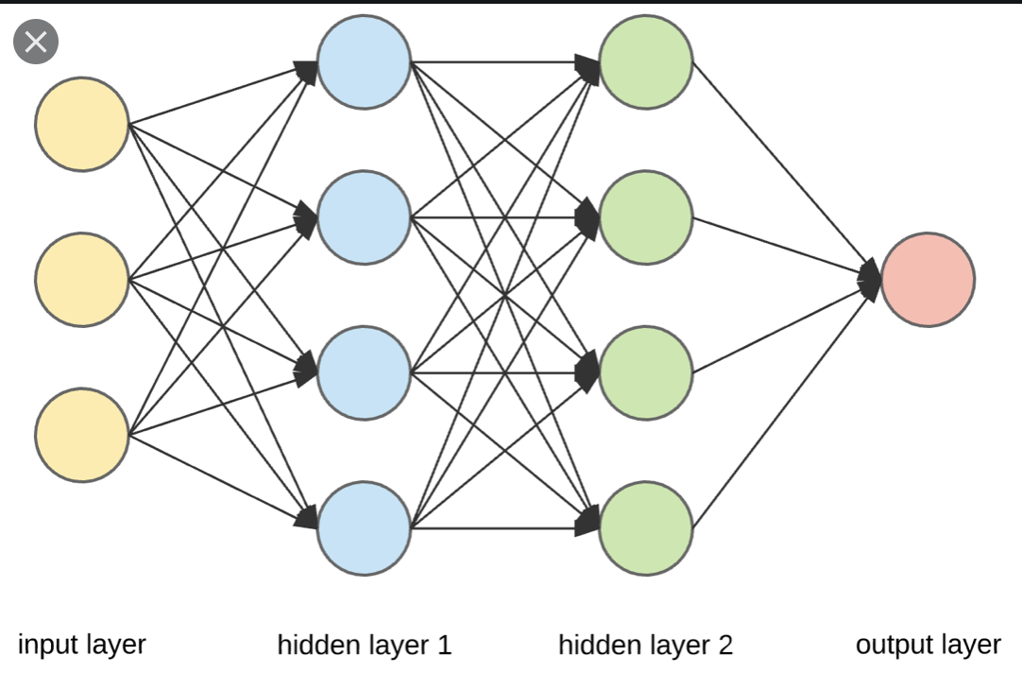
2.12 Neural networks
Artificial neural networks (ANN) or connectionist systems are computing systems vaguely inspired by the biological neural networks that constitute animal brains.
Such systems "learn" to perform tasks by considering examples, generally without being programmed with task-specific rules.

Slide 46
2.12 Neural networks
For example, in image recognition, they might learn to identify images that contain cats by analyzing example images that have been manually labeled as "cat" or "no cat" and using the results to identify cats in other images.
They do this without any prior knowledge of cats, for example, that they have fur, tails, whiskers and cat-like faces. Instead, they automatically generate identifying characteristics from the examples that they process.

Slide 47
2.13 Partial differential equations
In mathematics, a partial differential equation (PDE) is a differential equation that contains unknown multivariable functions and their partial derivatives.
PDEs are used to formulate problems involving functions of several variables, and are either solved by hand, or used to create a computer model.
A special case is ordinary differential equations (ODEs), which deal with functions of a single variable and their derivatives.

Slide 48
2.13 Partial differential equations
PDEs can be used to describe a wide variety of phenomena such as sound, heat, diffusion, electrostatics, electrodynamics, fluid dynamics, elasticity, gravitation and quantum mechanics.
These seemingly distinct physical phenomena can be formalised similarly in terms of PDEs.
Just as ordinary differential equations often model one-dimensional dynamical systems, partial differential equations often model multidimensional systems.
PDEs find their generalisation in stochastic partial differential equations.

Slide 49
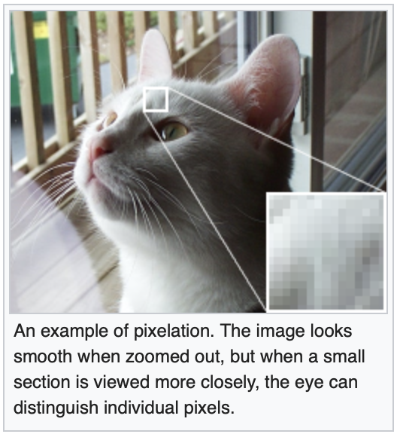
2.14 Pixelation
In computer graphics, pixelation
(or pixellation in British English) is caused by displaying a bitmap or a section of a bitmap at such a large size that individual pixels, small single-colored square display elements that comprise the bitmap, are visible.
Such an image is said to be pixelated (pixelated in the UK).

Slide 50
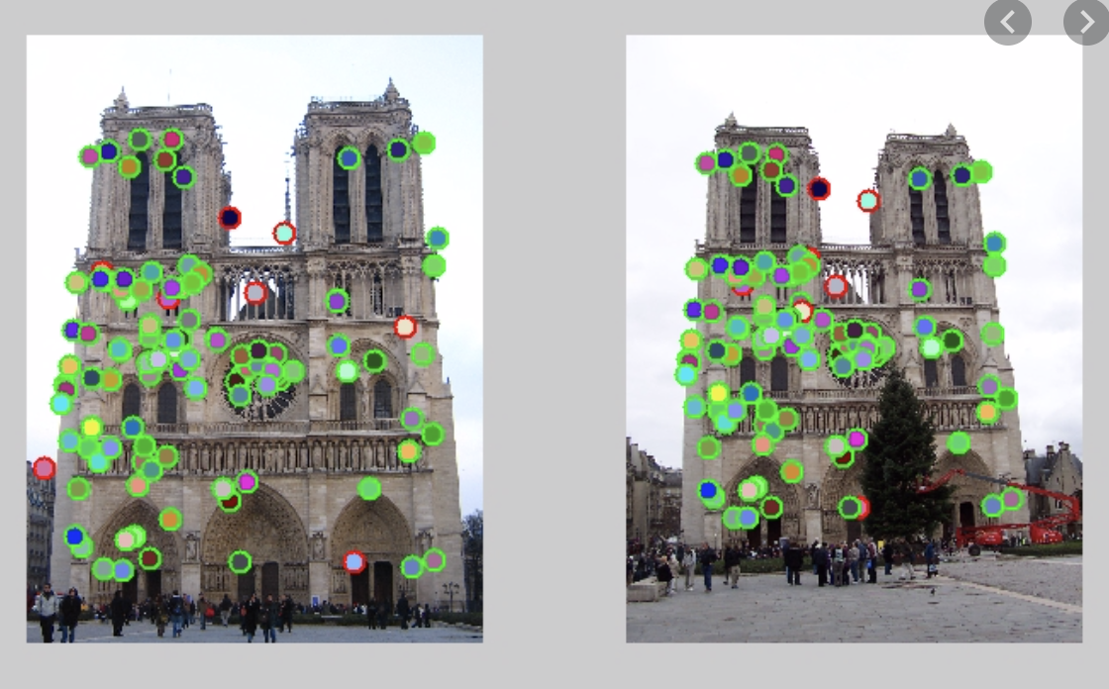
2.15 Point feature matching
In image processing, point feature matching is an effective method to detect a specified target in a cluttered scene.
This method detects single objects rather than multiple objects.
For instance, by using this method, one can recognize one specific person in a cluttered scene, but not any other person.

Slide 51
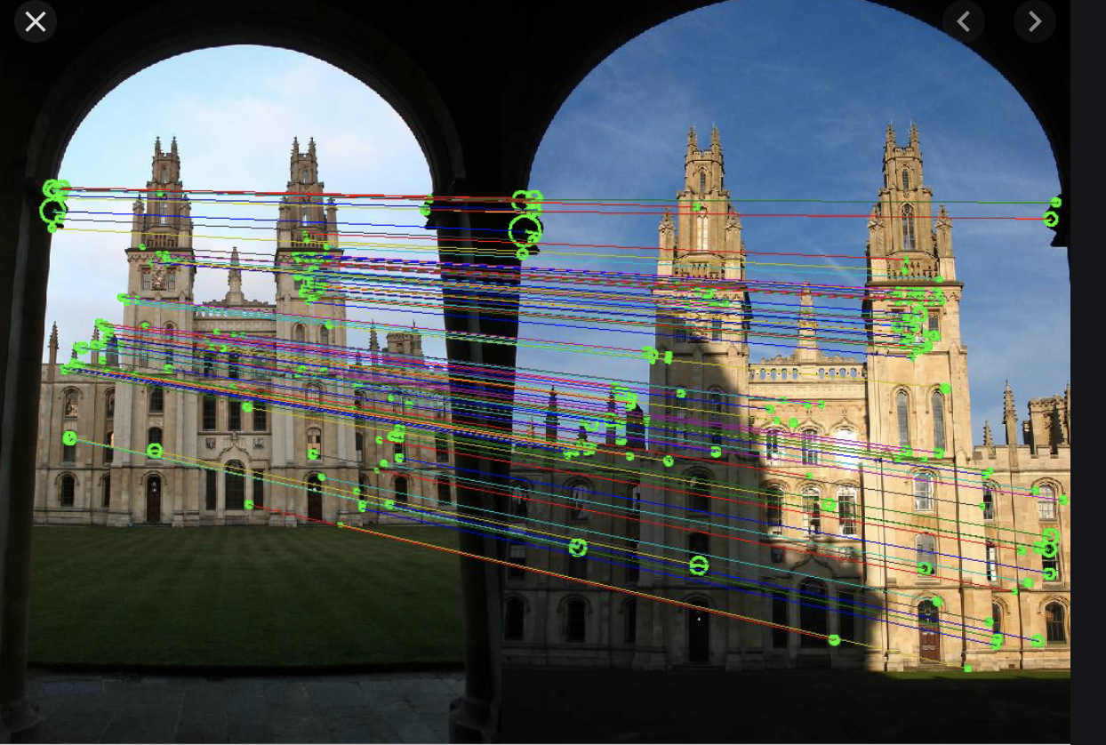
2.15 Point feature matching
The algorithm is based on comparing and analyzing point correspondences between the reference image and the target image.
If any part of the cluttered scene shares correspondences greater than the threshold, that part of the cluttered scene image is targeted and considered to include the reference object there.

Slide 52
2.16 Principal components analysis
Principal component analysis (PCA) is a statistical procedure that uses an orthogonal transformation to convert a set of observations of possibly correlated variables (entities each of which takes on various numerical values) into a set of values of linearly uncorrelated variables called principal components.

Slide 53
2.16 Principal components analysis
This transformation is defined in such a way that the first principal component has the largest possible variance (that is, accounts for as much of the variability in the data as possible), and each succeeding component in turn has the highest variance possible under the constraint that it is orthogonal to the preceding components.

Slide 54
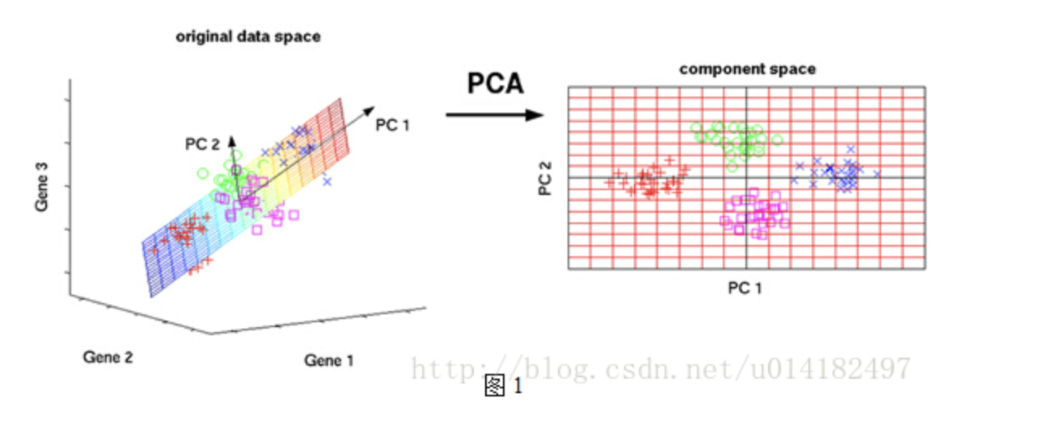
2.16 Principal components analysis
The resulting vectors (each being a linear combination of the variables and containing n observations) are an uncorrelated orthogonal basis set.
PCA is sensitive to the relative scaling of the original variables.

Slide 55
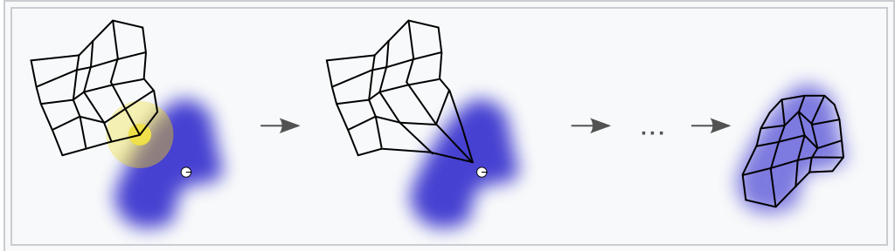
2.17 Self-organizing maps
A self-organizing map (SOM) or self-organizing feature map (SOFM) is a type of artificial neural network (ANN) that is trained using unsupervised learning to produce a low-dimensional (typically two-dimensional), discretized representation of the input space of the training samples, called a map, and is therefore a method to do dimensionality reduction.

Slide 56
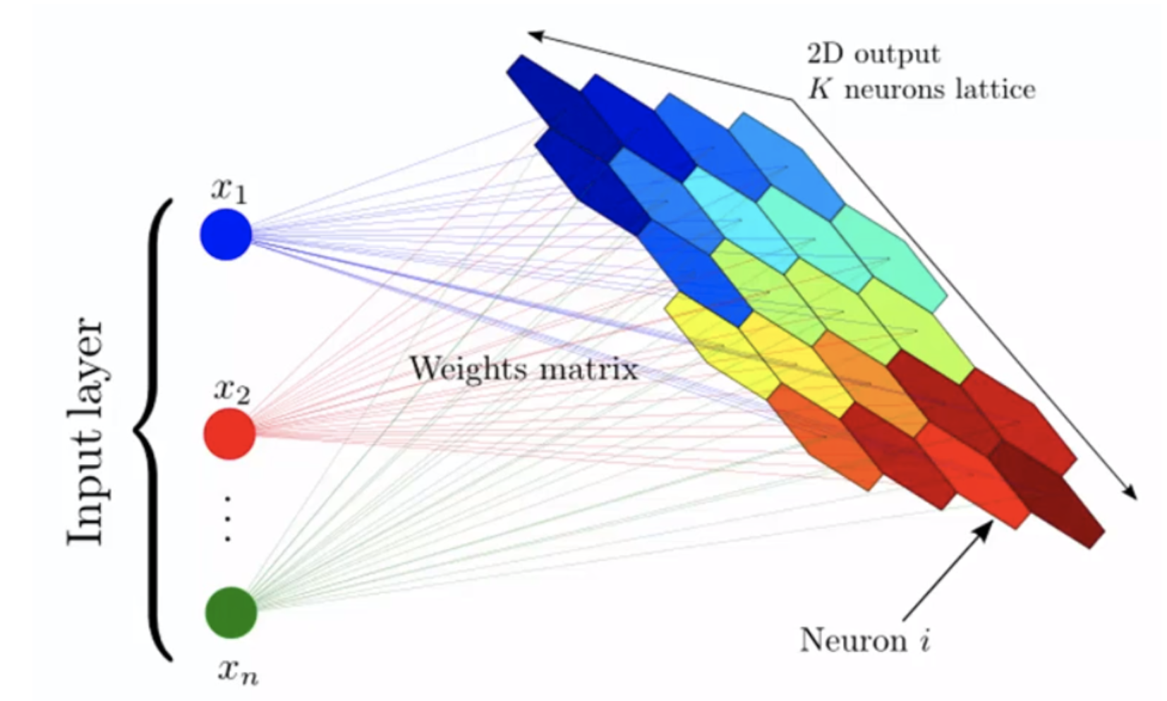
2.17 Self-organizing maps
Self-organizing maps differ from other artificial neural networks as they apply competitive learning as opposed to error-correction learning (such as backpropagation with gradient descent), and in the sense that they use a neighborhood function to preserve the topological properties of the input space.

Slide 57
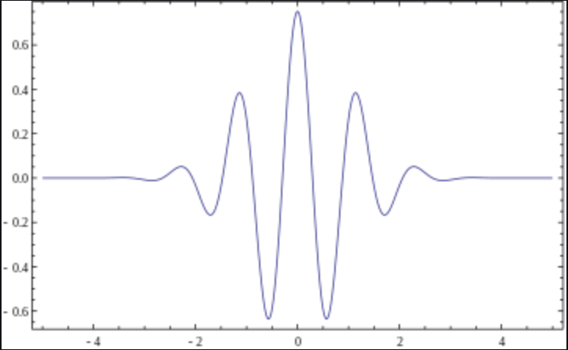
2.18 Wavelets
A wavelet is a wave-like oscillation with an amplitude that begins at zero, increases, and then decreases back to zero.
It can typically be visualized as a "brief oscillation" like one recorded by a seismograph or heart monitor.
Generally, wavelets are intentionally crafted to have specific properties that make them useful for signal processing. Using a "reverse, shift, multiply and integrate" technique called convolution, wavelets can be combined with known portions of a damaged signal to extract information from the unknown portions.

Slide 58
2.18 Wavelets
For example, a wavelet could be created to have a frequency of Middle C and a short duration of roughly a 32nd note.
If this wavelet were to be convolved with a signal created from the recording of a song, then the resulting signal would be useful for determining when the Middle C note was being played in the song. Mathematically, the wavelet will correlate with the signal if the unknown signal contains information of similar frequency.
This concept of correlation is at the core of many practical applications of wavelet theory.

Slide 59
2.18 Wavelets
As a mathematical tool, wavelets can be used to extract information from many different kinds of data, including – but not limited to – audio signals and images. Sets of wavelets are generally needed to analyze data fully.
A set of "complementary" wavelets will decompose data without gaps or overlap so that the decomposition process is mathematically reversible.
Thus, sets of complementary wavelets are useful in wavelet based compression/decompression algorithms where it is desirable to recover the original information with minimal loss.

Slide 60
2.18 Wavelets
In formal terms, this representation is a wavelet series representation of a square-integrable function with respect to either a complete, orthonormal set of basis functions, or an overcomplete set or frame of a vector space, for the Hilbert space of square integrable functions.
This is accomplished through coherent states.

Slide 61
3 Digital image transformations 3.1 Filtering
Digital filters are used to blur and sharpen digital images. Filtering can be performed by:
convolution with specifically designed kernels (filter array) in the spatial domain
masking specific frequency regions in the frequency (Fourier) domain

Slide 62
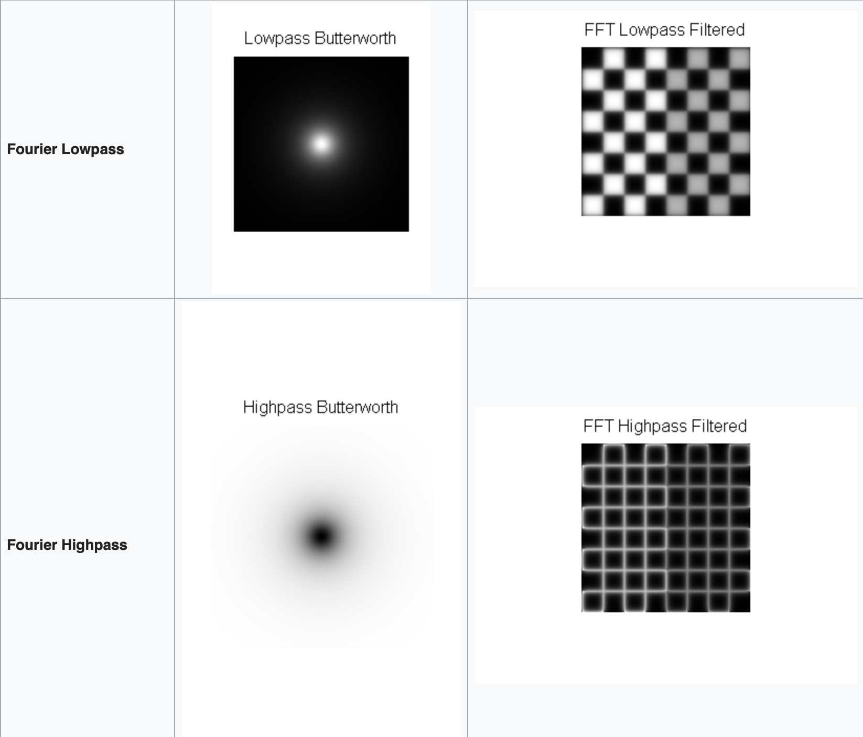
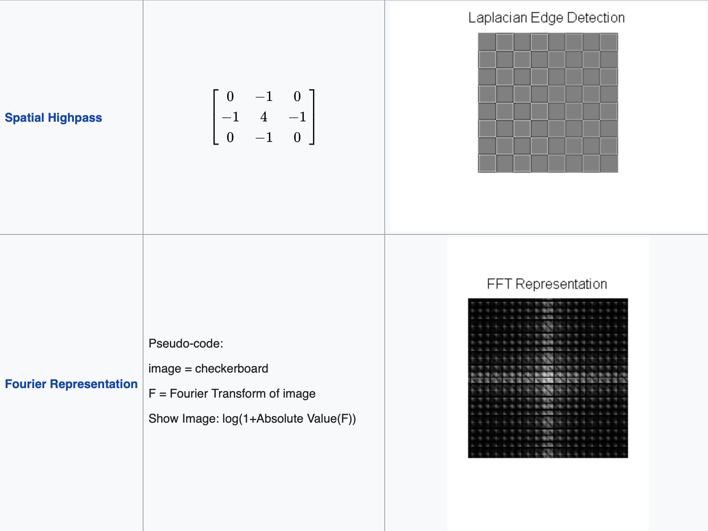
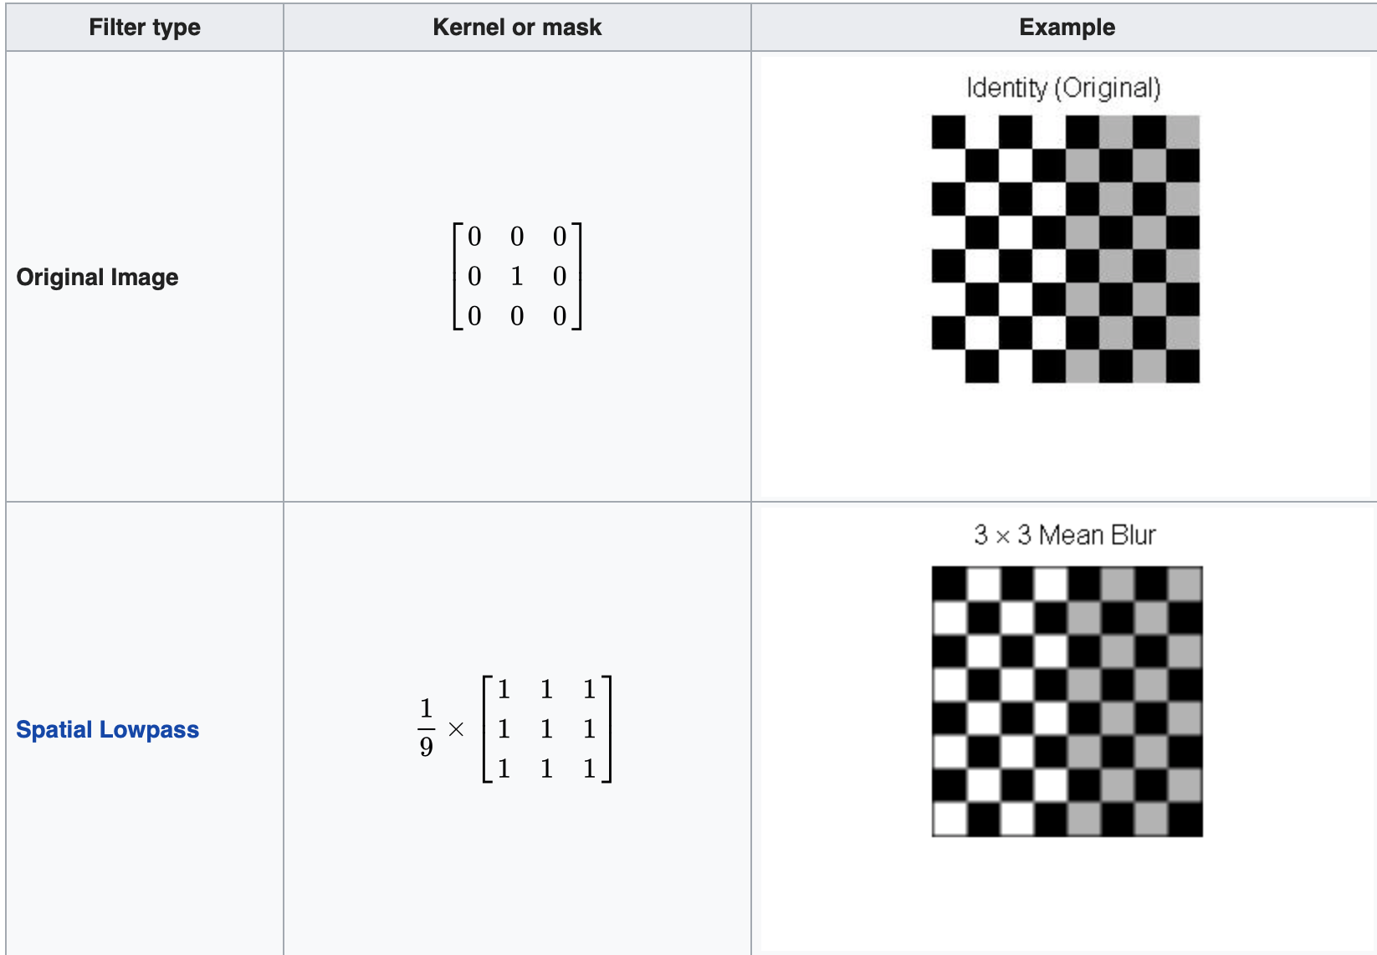
The following examples show both methods

Slide 63
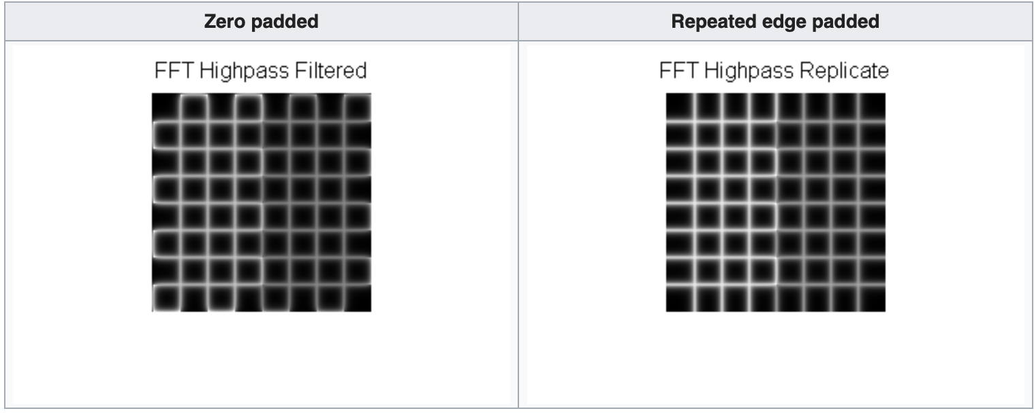
3.2 Image padding in Fourier domain filtering
Images are typically padded before being transformed to the Fourier space, the highpass filtered images below illustrate the consequences of different padding techniques:
Notice that the highpass filter shows extra edges when zero padded compared to the repeated edge padding.

Slide 64
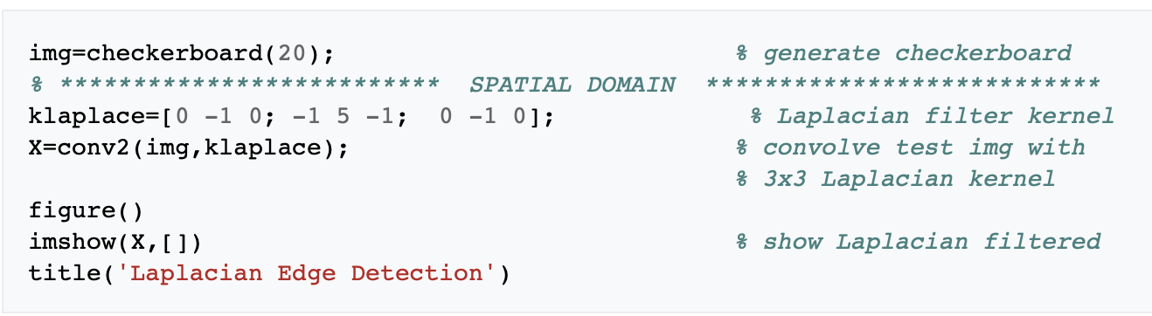
3.3 Filtering code examples
MATLAB example for spatial domain highpass filtering.

Slide 65
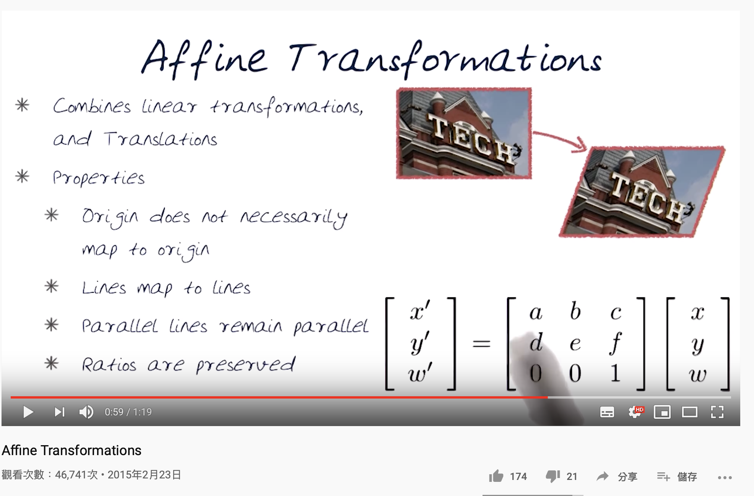
3.4 Affine transformations
Affine transformations enable basic image transformations including scale, rotate, translate, mirror and shear as is shown in the following examples:

Slide 66
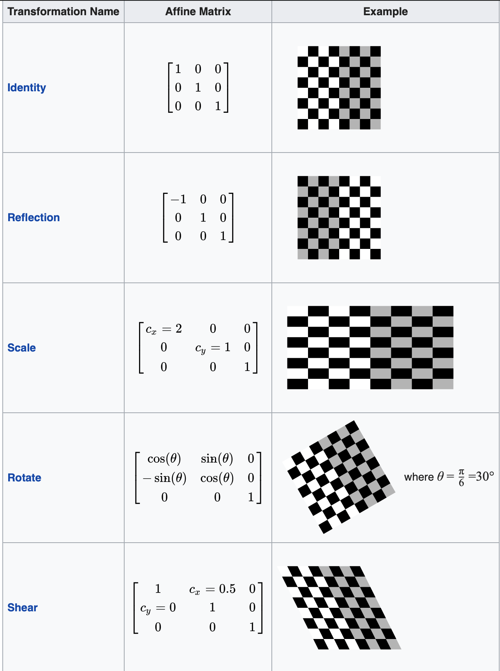
Notes:
To apply the affine matrix to an image, the image is converted to matrix in which each entry corresponds to the pixel intensity at that location. Then each pixel's location can be represented as a vector indicating the coordinates of that pixel in the image, [x, y], where x and y are the row and column of a pixel in the image matrix. This allows the coordinate to be multiplied by an affine-transformation matrix, which gives the position that the pixel value will be copied to in the output image.
However, to allow transformations that require translation transformations, 3 dimensional homogeneous coordinates are needed. The third dimension is usually set to a non-zero constant, usually 1, so that the new coordinate is [x, y, 1]. This allows the coordinate vector to be multiplied by a 3 by 3 matrix, enabling translation shifts. So the third dimension, which is the constant 1, allows translation.
Because matrix multiplication is associative, multiple affine transformations can be combined into a single affine transformation by multiplying the matrix of each individual transformation in the order that the transformations are done. This results in a single matrix that, when applied to a point vector, gives the same result as all the individual transformations performed on the vector [x, y, 1] in sequence. Thus a sequence of affine transformation matrices can be reduced to a single affine transformation matrix.
For example, 2 dimensional coordinates only allow rotation about the origin (0, 0). But 3 dimensional homogeneous coordinates can be used to first translate any point to (0, 0), then perform the rotation, and lastly translate the origin (0, 0) back to the original point (the opposite of the first translation). These 3 affine transformations can be combined into a single matrix, thus allowing rotation around any point in the image.

Slide 67


4 Applications
4.1 Digital camera images
4.2 Film
Digital cameras generally include specialized digital image processing hardware – either dedicated chips or added circuitry on other chips – to convert the raw data from their image sensor into a color-corrected image in a standard image file format.
Westworld (1973) was the first feature film to use the digital image processing to pixellate photography to simulate an android's point of view.

Slide 68
5 See also
Computer graphics
Computer vision
CVIPtools
Digitizing
Free boundary condition
GPGPU
Homomorphic filtering
Image analysis
IEEE Intelligent Transportation Systems Society
Multidimensional systems
Remote sensing software
Standard test image
Superresolution
Total variation denoising
Machine Vision
Bounded variation
Radiomics

Slide 69
6 References
Chakravorty, Pragnan (2018). "What is a Signal? [Lecture Notes]". IEEE Signal Processing Magazine. 35 (5): 175–177. Bibcode:2018ISPM...35..175C. doi:10.1109/MSP.2018.2832195.
^ Gonzalez, Rafael (2018). Digital image processing. New York, NY: Pearson. ISBN 978-0-13-335672-4. OCLC 966609831.
^ Azriel Rosenfeld, Picture Processing by Computer, New York: Academic Press, 1969
^ Jump up to: ª ^{b} Gonzalez, Rafael C. (2008). Digital image processing. Woods, Richard E. (Richard Eugene), 1954- (3rd ed.). Upper Saddle River, N.J.: Prentice Hall. pp. 23–28. ISBN 9780131687288. OCLC 137312858.
^ Jump up to: ª ^{b} ^{c} Williams, J. B. (2017). The Electronics Revolution: Inventing the Future. Springer. pp. 245–8. ISBN 9783319490885.
^ "1960: Metal Oxide Semiconductor (MOS) Transistor Demonstrated". The Silicon Engine. Computer History Museum. Archived from the original on 3 October 2019. Retrieved 31 August 2019.
^ James R. Janesick (2001). Scientific charge-coupled devices. SPIE Press. pp. 3–4. ISBN 978-0-8194-3698-6.
^ Boyle, William S; Smith, George E. (1970). "Charge Coupled Semiconductor Devices". Bell Syst. Tech. J. 49 (4): 587–593. doi:10.1002/j.1538-7305.1970.tb01790.x.
^ Fossum, Eric R. (12 July 1993). "Active pixel sensors: Are CCDS dinosaurs?". In Blouke, Morley M. (ed.). Charge-Coupled Devices and Solid State Optical Sensors III. Proceedings of the SPIE. 1900. pp. 2–14. Bibcode:1993SPIE.1900....2F. CiteSeerX 10.1.1.408.6558. doi:10.1117/12.148585.
^ Fossum, Eric R. (2007). "Active Pixel Sensors" (PDF). Semantic Scholar. Archived (PDF) from the original on 9 March 2019. Retrieved 8 October 2019.

Slide 70
6 References
Matsumoto, Kazuya; et al. (1985). "A new MOS phototransistor operating in a non-destructive readout mode". Japanese Journal of Applied Physics. 24 (5A): L323. Bibcode:1985JaJAP..24L.323M. doi:10.1143/JJAP.24.L323.
^ Fossum, Eric R.; Hondongwa, D. B. (2014). "A Review of the Pinned Photodiode for CCD and CMOS Image Sensors". IEEE Journal of the Electron Devices Society. 2 (3): 33–43. doi:10.1109/JEDS.2014.2306412.
^ "CMOS Image Sensor Sales Stay on Record-Breaking Pace". IC Insights. 8 May 2018. Archived from the original on 21 June 2019. Retrieved 6 October 2019.
^ Ahmed, Nasir (January 1991). "How I Came Up With the Discrete Cosine Transform". Digital Signal Processing. 1 (1): 4–5. doi:10.1016/1051-2004(91)90086-Z. Archived from the original on 10 June 2016. Retrieved 10 October 2019.
^ "T.81 – DIGITAL COMPRESSION AND CODING OF CONTINUOUS-TONE STILL IMAGES – REQUIREMENTS AND GUIDELINES" (PDF). CCITT. September 1992. Archived (PDF) from the original on 17 July 2019. Retrieved 12 July 2019.
^ "The JPEG image format explained". BT.com. BT Group. 31 May 2018. Archived from the original on 5 August 2019. Retrieved 5 August 2019.
^ "What Is a JPEG? The Invisible Object You See Every Day". The Atlantic. 24 September 2013. Archivedfrom the original on 9 October 2019. Retrieved 13 September 2019.
^ Baraniuk, Chris (15 October 2015). "Copy protections could come to JPEGs". BBC News. BBC. Archivedfrom the original on 9 October 2019. Retrieved 13 September 2019.
^ Grant, Duncan Andrew; Gowar, John (1989). Power MOSFETS: theory and applications. Wiley. p. 1. ISBN 9780471828679. The metal-oxide-semiconductor field-effect transistor (MOSFET) is the most commonly used active device in the very large-scale integration of digital integrated circuits (VLSI). During the 1970s these components revolutionized electronic signal processing, control systems and computers.
^ Shirriff, Ken (30 August 2016). "The Surprising Story of the First Microprocessors". IEEE Spectrum. Institute of Electrical and Electronics Engineers. Archived from the original on 13 October 2019. Retrieved 13 October2019.

Slide 71
6 References
"1979: Single Chip Digital Signal Processor Introduced". The Silicon Engine. Computer History Museum. Archived from the original on 3 October 2019. Retrieved 14 October 2019.
^ Taranovich, Steve (27 August 2012). "30 years of DSP: From a child's toy to 4G and beyond". EDN. Archived from the original on 14 October 2019. Retrieved 14 October 2019.
^ Stanković, Radomir S.; Astola, Jaakko T. (2012). "Reminiscences of the Early Work in DCT: Interview with K.R. Rao" (PDF). Reprints from the Early Days of Information Sciences. 60. Archived (PDF) from the original on 13 October 2019. Retrieved 13 October 2019.
^ "Space Technology Hall of Fame:Inducted Technologies/1994". Space Foundation. 1994. Archived from the original on 4 July 2011. Retrieved 7 January 2010.
^ Zhang, M. Z.; Livingston, A. R.; Asari, V. K. (2008). "A High Performance Architecture for Implementation of 2-D Convolution with Quadrant Symmetric Kernels". International Journal of Computers and Applications. 30 (4): 298–308. doi:10.1080/1206212x.2008.11441909.
^ Jump up to: ª ^{b} Gonzalez, Rafael (2008). Digital Image Processing, 3rd. Pearson Hall. ISBN 9780131687288.
^ House, Keyser (6 December 2016). Affine Transformations (PDF). Clemson. Foundations of Physically Based Modeling & Animation. A K Peters/CRC Press. ISBN 9781482234602. Archived (PDF) from the original on 30 August 2017. Retrieved 26 March 2019.
^ A Brief, Early History of Computer Graphics in Film Archived 17 July 2012 at the Wayback Machine, Larry Yaeger, 16 August 2002 (last update), retrieved 24 March 2010

Slide 72
7 Further reading
Solomon, C.J.; Breckon, T.P. (2010). Fundamentals of Digital Image Processing: A Practical Approach with Examples in Matlab. Wiley-Blackwell. doi:10.1002/9780470689776. ISBN 978-0470844731.
Wilhelm Burger; Mark J. Burge (2007). Digital Image Processing: An Algorithmic Approach Using Java. Springer. ISBN 978-1-84628-379-6.
R. Fisher; K Dawson-Howe; A. Fitzgibbon; C. Robertson; E. Trucco (2005). Dictionary of Computer Vision and Image Processing. John Wiley. ISBN 978-0-470-01526-1.
Rafael C. Gonzalez; Richard E. Woods; Steven L. Eddins (2004). Digital Image Processing using MATLAB. Pearson Education. ISBN 978-81-7758-898-9.
Tim Morris (2004). Computer Vision and Image Processing. Palgrave Macmillan. ISBN 978-0-333-99451-1.
Milan Sonka; Vaclav Hlavac; Roger Boyle (1999). Image Processing, Analysis, and Machine Vision. PWS Publishing. ISBN 978-0-534-95393-5.
Rafael C. Gonzalez (2008). Digital Image Processing. Prentice Hall. ISBN 9780131687288

Slide 73
8 External links
Lectures on Image Processing, by Alan Peters. Vanderbilt University. Updated 7 January 2016.
IPRG Open group related to image processing research resources
Processing digital images with computer algorithms
IPOL Open research journal on image processing with software and web demos.

